Slide 1
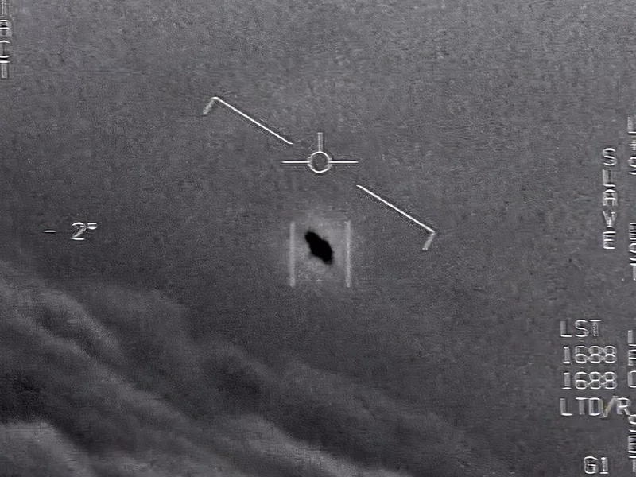
UFO SIGHTINGS REPORTED
(National UFO Reporting Center)
ᐧ Allison Wells ᐧ Claudia Yurrita ᐧ Rosanna Reza-Giles ᐧ Alex Delacruz ᐧ
Notes:
Intro idea: As you may have heard in the news recently, UFOs are a big topic, especially as our military is releasing information about "UAP"s (Unidentified Aerial Phenomena).
We wanted to pick a fun topic, but also one that is relevant to this news today.
Our analysis will use sorting, graphing, and cleaning of self reported data to see if there are trends in the public's relationship with UFOs

Slide 2
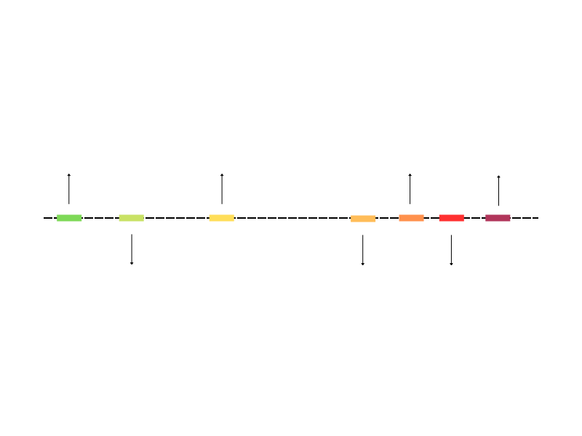
MODERN UFO TIMELINE IN USA
1947-1969 Project Blue Book summarize USAF investigations of UFOS
1940-1950 Era of the “flying saucer” phenomena
2004-2012 Military has reported 400+ UFOs
Notes:
Alex: In 1947 a business and pilot Kenneth Arnold said he had an encounter with an UFO, event that prompt a renewed interest in them. Before him pilots in WWI reported sightings. After that the “abduction” of Barney and Betty Hills spread fear between the community. The government tried to control the frensi and documented the sightings. It was in 2017 when the University of Hawaii telescope got a real unidentified object (Oumuamua) it pased near the sun and left the solar system. In 2020 Penns state began his efforts to detect tech signatures. 2021 was the first Congressional hearing about UFOs and the documents were made available to the public 2022 Harvard launches a project and the government began his first serious steps towards find the existence of extraterrestrial life.

Slide 3
THE NATIONAL UFO REPORTING CENTER
Founded in 1974.
Non governmental.
Non profit.
Provides a hotline for reporting sightings.
Debug the reports received discarding some fakes.
Database with more than 80,000 reports.
Notes:
Alex: This center has an impressive database (over 80,000 rows until 2013). And the only one we found available to the public. MUFON, the most prominent UFO data collectors in the US, have worked with the National UFO Reporting Center, to publicise trends in public sightings reporting.
We do have to acknowledge all of our data is self-reported, but this led to interesting questions about trends in public experiences over time and location. Do these trends align with pop culture or perhaps is a type of reported UFO regional?

Slide 4
QUESTIONS WE HOPE TO ANSWER
LOCATIONS
Are there locations where more people report sightings occurring?
NUMBERS
Has there been a change in the number of UFO sights reported over time?
TYPES
Is there any change in the type of UFO reported over time or location?
RELATIONS
Who was with the reporter when the event occur?
Notes:
Alex: Read through the questions that we plan to address.

Slide 5
THE PROCESS
Notes:
Claudia starts here

Slide 6
CLEANING OF THE DATABASE
Steps followed:
Check and correct column names.
Check and correct datatypes.
Correct typos and group similar data.
Verify the completeness of the dataset.
Problems found:
Json didn’t support datetime types.
We tried to parse them as iso but didn’t work.
Our solution was to return the dates to a datatype string.
Source: Kaggle with data from the NURC
Time Frame: 1949 -2013
Original Inputs: Scrubbed file.
Notes:
The scrubbed database was a ‘joke’ it has many typos and peculiarities that made the process cumbersome

Slide 7
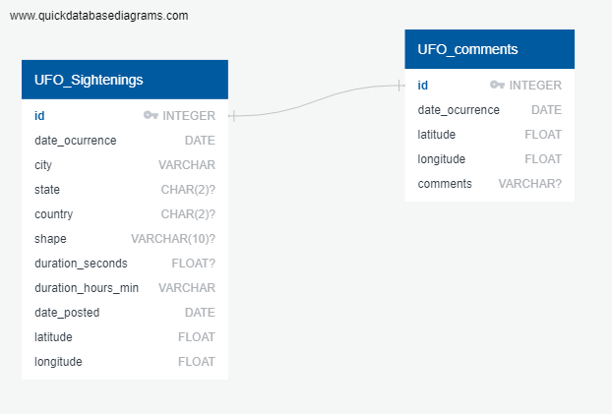
GENERATING POSTGRES DATABASE
Notes:
We really didn’t need to relate them but still is a good exercise

Slide 8
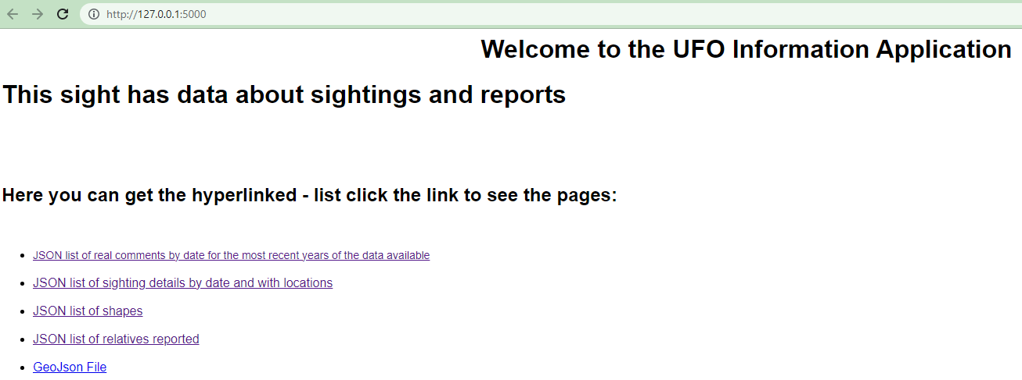
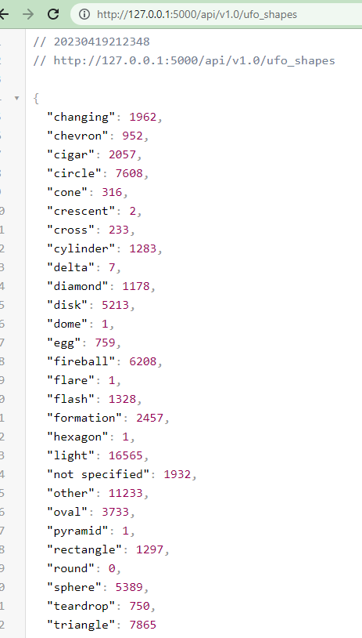
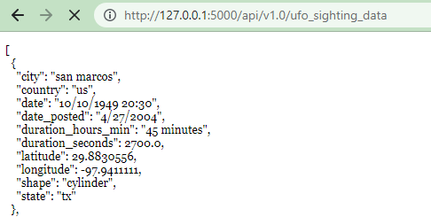
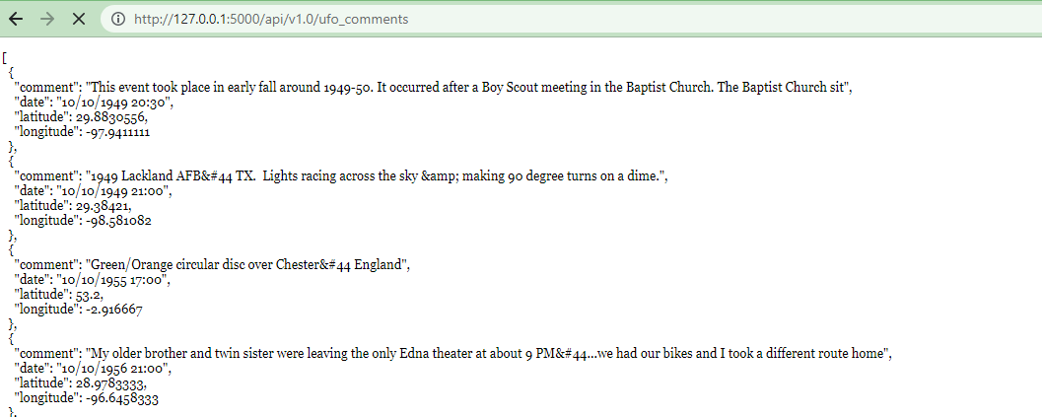
FLASK APPLICATION
Descriptive Analysis
Verbatim descriptions
Quick reference of data
Reference to other people
Notes:
The Flask application was done with the intention of bringing not just all the information available but to give a little more insight to the databases. The links to the apis were thought for easiness of use.
However the extent of the database and the datatypes of the dates (datetime format) were making the uploading slow. The problem went away when when changed the dates to strings.

Slide 9
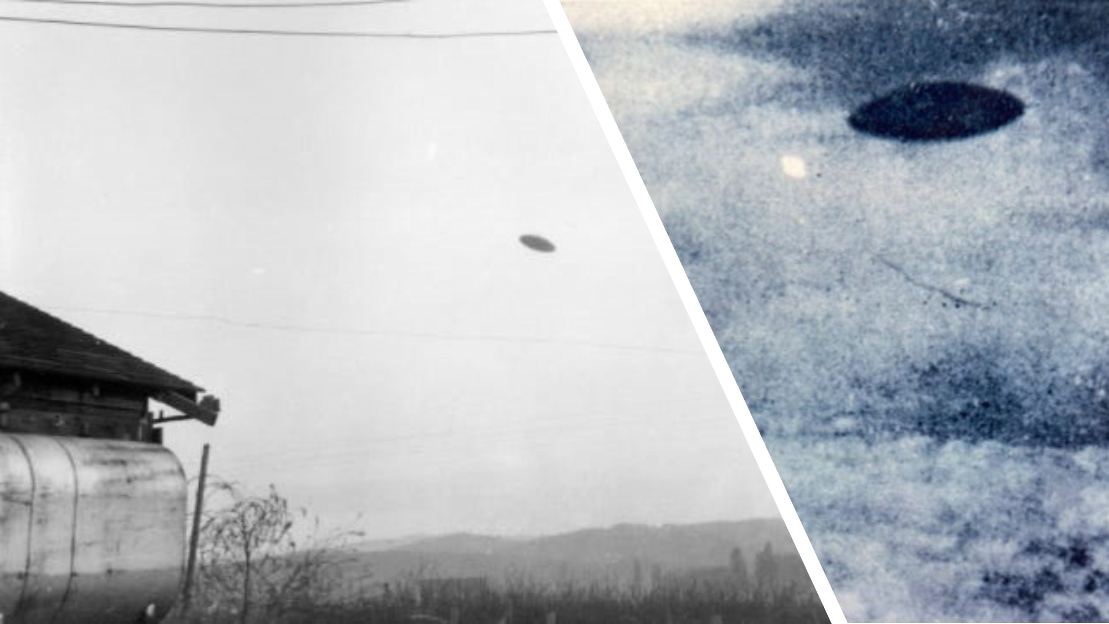
THE RESULTS
Notes:
The results honestly left us asking more questions than we started off with. As the information was self reported and not held to any real standard of reliability we were not prepared for the intense processing that had to be done to arrive at any conclusive results except the idea that the truth is out there. In retrospect I believe the real data has value as it is completely voluntary with no perceivable “reward” or “punishment” attributed to it’s collection. We can speak to the usual metrics, sights over time, frequency by location mean duration of sights and such; but I think it’s true value comes when it is layered over other historical, geopolitical and even astrological events.

Slide 10
ALIEN REPORTS 1949-2013
1,905 reports
GREAT BRITAIN
CANADA
DENMARK
3,000 reports
105 reports
USA
65,114 reports
AUSTRALIA
538 reports
Notes:
The database consists of 80,317 rows, from those 70,662 are reported in these five countries.Reports from the USA are the most complete while those from the other countries lack mention to the state where they occurred. The rest of the reports don’t mention the country, however they do have the coordinates for mapping. It would have been valuable to map event proximity and similar appearance. The ability of people to freeform their responses was a hindrance to consistency in the data, mom, mommy, mama, had to be processed and filtered as although they are synonyms they come through as unique values. Shapes had the same issue.

Slide 11
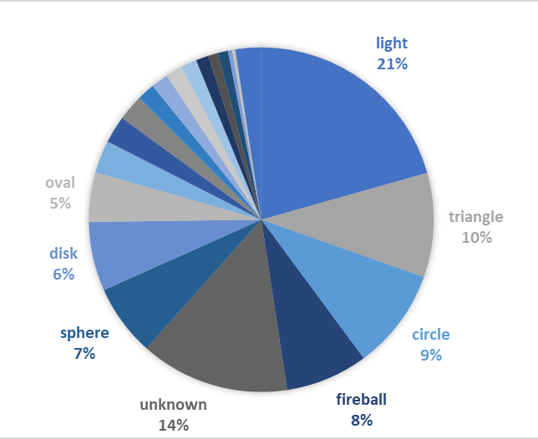
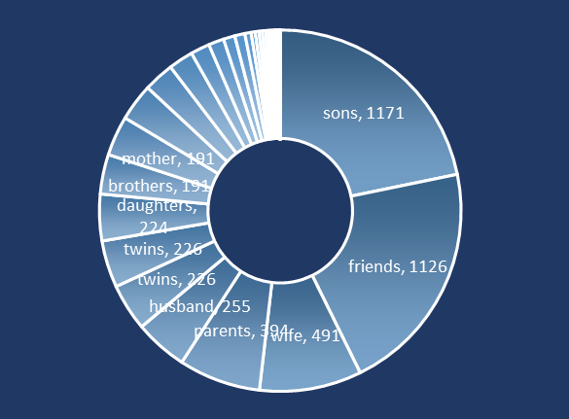
FREQUENCIES IN THE REPORTS
SHAPES
MENTIONS
Notes:
Most of the people reported seeing lights when they refer to the sights. The next common forms reported are triangle and circle. Even though I think some of these forms could have been grouped we decided to adhere to the factual information and took very few liberties in this process. The second distribution shows the frequency of second witness and relationships to those witnesses. We Found interesting searching for strings inside the text.

Slide 12

FREQUENCIES IN THE REPORTS
Notes:
Alex’s map shows United States distribution reported over the life of the reported data, starting at 20:30 on October 10, 1949 to 23:00 on September 09, 2013. Seattle being the top reporter with 525 sightings, Phoenix with 454, Portland 374, Las Vegas 368. By state CA 9655, WA 4268, FL 4200, Texas 3677, NY 3219. Most by county- US 65114 - CA 3000-Great Britain, Australia 538,

Slide 13
THE DASHBOARD
Notes:
The Arrival 1996
Alien Resurrection 1997
Men in Black 1997
The Fifth Element 1997
Independence Day 1996
Starship Troopers 1997

Slide 14



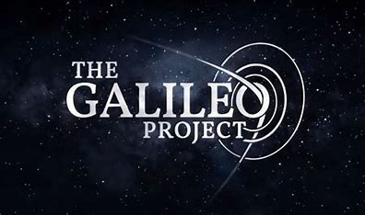

A SCIENTIFIC APPROACH
PENN STATE
HARVARD
NASA
SETI Institute
AOIMSG
Search for Extraterrestrial Intelligence
Search Extraterrestrial Technology Signatures
Develop a method to identify
Explore and Understand Life in Universe
US Military Group Formed to Study UAP
Notes:
Now, many institutions are taking the task to find evidence on this phenomena in a serious manner. Founded in 2020, PSETI (Penn State Extraterrestrial Intelligence Center) aims to find extraterrestrial technological life in the universe via technosignatures.
Galileo project Created 2021. Search extraterrestrial technosignatures.
SETI Institute searches for physical objects, study of life in the universe, astronomy, astrobiology and space science for students and educators.
Lead humanity’s quest to understand the origin and prevalence of life and intelligence in the universe. Created 1984
The Unidentified Aerial Phenomena Task Force (2020) restructured to the All-domain Anomaly Resolution Office (AARO) in 2021.
Many of these were created since the release of

